Slide 1
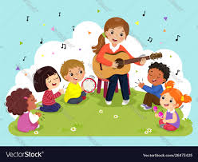
Connect Plus 2 Unit 11 Let's sing.
D O L S
Mrs Rehab

Slide 2
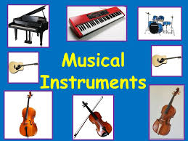

Slide 3

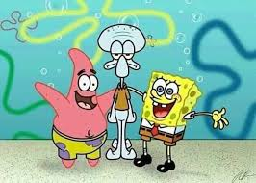
What is a musical instrument?
D O L S
Mrs Rehab
It is a tool that helps us play music .
A piano for example

Slide 4

Let's learn some more instruments

Slide 5
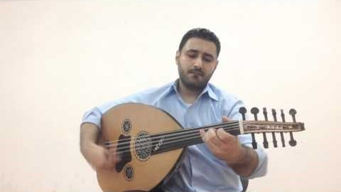
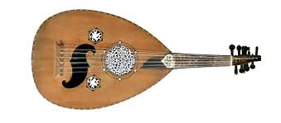
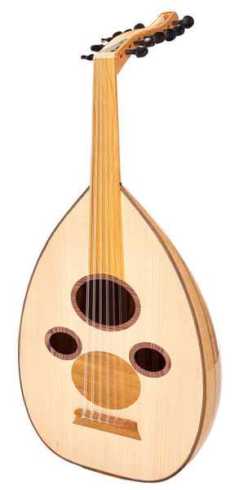
oud
D O L S
Mrs Rehab

Slide 6
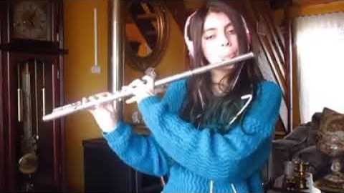
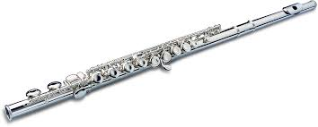
Flute
D O L S
Mrs Rehab

Slide 7
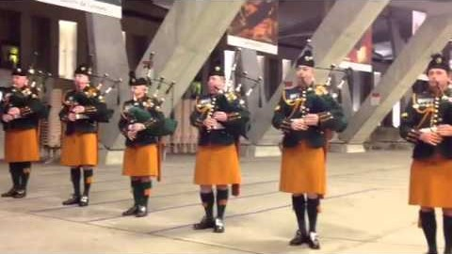
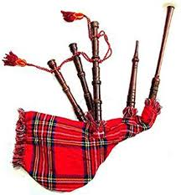
Bag pipe
D O L S
Mrs Rehab

Slide 8

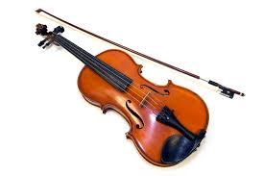
violin
D O L S
Mrs Rehab

Slide 9
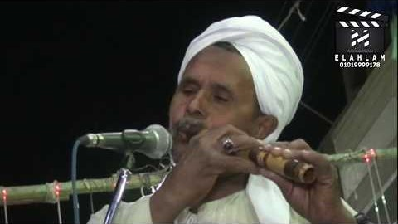
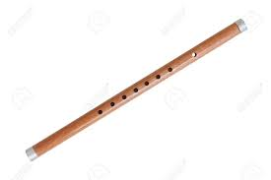
reed pipe
D O L S
Mrs Rehab

Slide 10
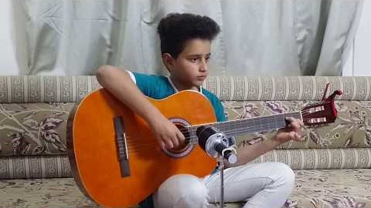
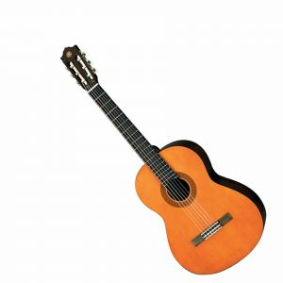
Guitar
D O L S
Mrs Rehab

